Slide 1
Digital bestillingsprosess for Armering, direkte fra modell
Per Ole Otterness, Jan Tore Bugge
Symetri AS
Notes:
USE if needed: Cad-Q is now Symetri. Growing from CAD professional (Cad-Q) to expert in multiple areas (Symetri) of with CAD is still an important part, although just one of our total offering.
From expert in CAD software to a strategic business partner supporting our clients at every stage of the product or building life cycle. Although still an integral part of our business, today, CAD is just one of the many components we offer. So, to mark our transformation and better reﬂect the multifaceted nature of our solutions we have now taken a new name.
2 interesting ? To make…
-Whats wrong with CAD (nothing…..CAD is still very important to our business, but we want to focus on process in where CAD interacts, and be a advisor to more than CAD software (deliver more services and own tech))
-Why is this good for me as a customer (in the highest potential, we want to deliver solutions and services that gives our customers a competitive advantage)

Slide 2
Digital bestillingsprosess for Armering
Symetri er i ferd med å utvikle en nettbasert programuavhengig løsning for digital bestilling av armering, basert på åpenBIM (IFC).
Løsningen er rettet spesielt mot entreprenører og formenn med ansvar for bestillingsprosessen, og produserer grunnlag for bøyebenker. Løsningen bidrar til å plassere ansvaret for bestillingsprosessen hos riktig aktør.
Notes:
USE if needed: Cad-Q is now Symetri. Growing from CAD professional (Cad-Q) to expert in multiple areas (Symetri) of with CAD is still an important part, although just one of our total offering.
From expert in CAD software to a strategic business partner supporting our clients at every stage of the product or building life cycle. Although still an integral part of our business, today, CAD is just one of the many components we offer. So, to mark our transformation and better reﬂect the multifaceted nature of our solutions we have now taken a new name.
2 interesting ? To make…
-Whats wrong with CAD (nothing…..CAD is still very important to our business, but we want to focus on process in where CAD interacts, and be a advisor to more than CAD software (deliver more services and own tech))
-Why is this good for me as a customer (in the highest potential, we want to deliver solutions and services that gives our customers a competitive advantage)

Slide 3
Agenda
Bakgrunn for utviklingen
Prosessen
Teknologien
Demonstrasjon
Agenda
Notes:
USE if needed: Cad-Q is now Symetri. Growing from CAD professional (Cad-Q) to expert in multiple areas (Symetri) of with CAD is still an important part, although just one of our total offering.
From expert in CAD software to a strategic business partner supporting our clients at every stage of the product or building life cycle. Although still an integral part of our business, today, CAD is just one of the many components we offer. So, to mark our transformation and better reﬂect the multifaceted nature of our solutions we have now taken a new name.
2 interesting ? To make…
-Whats wrong with CAD (nothing…..CAD is still very important to our business, but we want to focus on process in where CAD interacts, and be a advisor to more than CAD software (deliver more services and own tech))
-Why is this good for me as a customer (in the highest potential, we want to deliver solutions and services that gives our customers a competitive advantage)

Slide 4
5 COUNTRIES
20 OFFICES
About Symetri
Notes:
Other:
-Nærvær og fokus på det lokale marked, med en stærk organisation i ryggen…..
-Vi udveksler viden og erfaringer med kollegaer i Symetri koncernen til fordel for vore kunder
-Ingen kunde er for lille (eller for stor…..)
-Største AD forhandler i Nordeuropa

Slide 5
Symetri Produkt-portefølje for BA-bransjen
Autodesk
Naviate
BIMeye
About Symetri
Notes:
USE if needed: Cad-Q is now Symetri. Growing from CAD professional (Cad-Q) to expert in multiple areas (Symetri) of with CAD is still an important part, although just one of our total offering.
From expert in CAD software to a strategic business partner supporting our clients at every stage of the product or building life cycle. Although still an integral part of our business, today, CAD is just one of the many components we offer. So, to mark our transformation and better reﬂect the multifaceted nature of our solutions we have now taken a new name.
2 interesting ? To make…
-Whats wrong with CAD (nothing…..CAD is still very important to our business, but we want to focus on process in where CAD interacts, and be a advisor to more than CAD software (deliver more services and own tech))
-Why is this good for me as a customer (in the highest potential, we want to deliver solutions and services that gives our customers a competitive advantage)

Slide 6
Consultancy
A Symetri consultant is your guarantee for certified and experienced knowhow….
Installation and configuration
Project support
Cad-Walk
Workshops
Development
Advisory
9 Competence
centres
100
Consultants
Business in Northern Europe - Local presence

Slide 7
Bakgrunn
3D armering stadig mer utbredt
Ønsker og krav om digital bestilling av armering.
Teknologien er på plass (BVBS, XML).
Prosessen er ikke på plass.

Slide 8
Workshop
Deltagere:
Prosjekterende (3D Armering)
Entreprenør
Leverandør
Formålet:
Beskrive og enes om prosessen for digital bestilling av armering med basis i BIM-modellen.

Slide 9
Workshop
Resultatet:

Slide 10
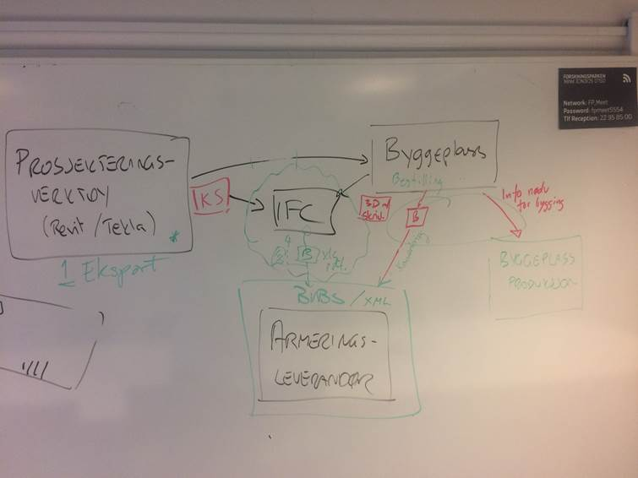
Workshop
Resultatet:

Slide 11
Beskrivelse av prosessen
Web-dB:
Rådgiver: 3D Armering
Byggeplass:
Formann
Jernbinder
IFC
1. Pakker, bestilling.
STATUS, SYNK
2. Leveranse byggeplass.
TEGNINGS-PAKKE
BVBS, BØYELISTE
Produsent

Slide 12
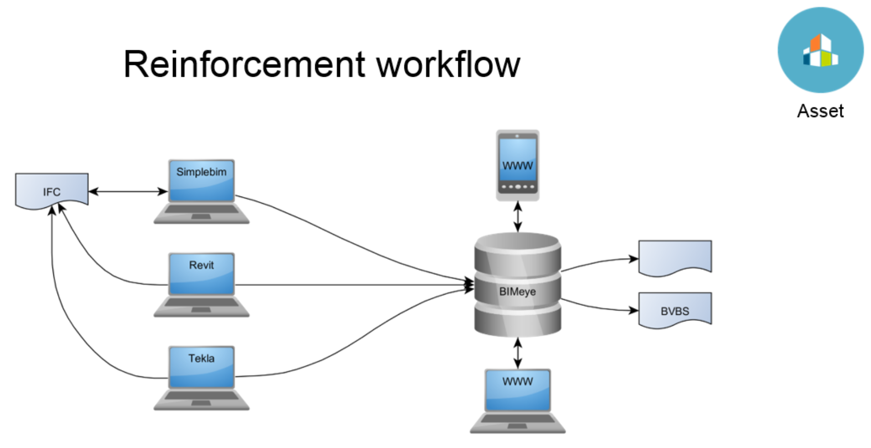
Teknologi

Slide 13
Demonstrasjon
Visning av Entreprenørens grensesnitt.

