Slide 1
Framework for Product Data Templates

Slide 2
Product Data Templates (PDT)
Generic datasets containing all relevant data for a product - Performance data (relevant for a building or infrastructure)
…but also: - Geometric data - Operational and Maintenance Data - Manufactures Data - Features Data - Environmental Data A PDT is interoperable – holds languages, stages and formats
Not a part of the suggested standard
(but explains what a PDT can hold)

Slide 3
NWIP in CEN/TC 442 WG4 from Norway
Product data templates based on CEN/CENELEC standards in an open European Data Dictionary Part 1: General structure of a product data template and how to relate to Industry Foundations Classes (IFC)
Product data templates based on CEN/CENELEC standards in an open European Data Dictionary. Part 2: Framework for product data templates based on harmonised technical specifications under the Construction Products Regulation (CPR), and how to relate the product data templates to Industry Foundation Classes (IFC)

Slide 4
Background

Slide 5
ProductInfoX project
The European Construction Industry Federation (FIEC)
The International Union of Painting Contractors
The Norwegian Contractors Association (EBA)
Read more at: www.productinfox.eu , https://youtu.be/jLR67V1I8mM

Slide 6
ProductInfoX project
Aim
Address the common challenge faced by the SMEs in the construction sector of collecting and using information on products and equipment
Help actors in the construction industry to collect and distribute relevant data associated with the free flow of construction products throughout The design-build-operate life cycle of construction assets
Understanding the Construction Products Regulation with its 7 basic requirements, and the common technical language to assess the performance of construction products

Slide 7
Construction Products Regulation (CPR)

Slide 8
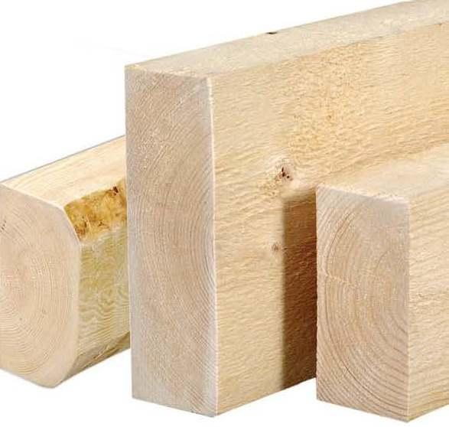
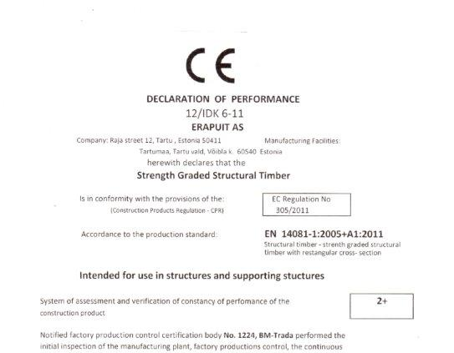
Construction Product Regulation (CPR)
Essential
Characteristics
1. Mechanical resistance and stability
2. Safety in case of fire
3. Hygiene, health and the environment
4. Safety and accessibility in use
5. Protection against noise
6. Energy economy and heat retention
7. Sustainable use of natural resources

Slide 9
CPR
Lays down harmonised rules for the marketing of construction products in the EU
Provides a common technical language to assess the performance of construction products
Ensures reliable information is available to professionals, public authorities, and consumers, so they can compare the performance of products from different manufacturers in different countries.

Slide 10
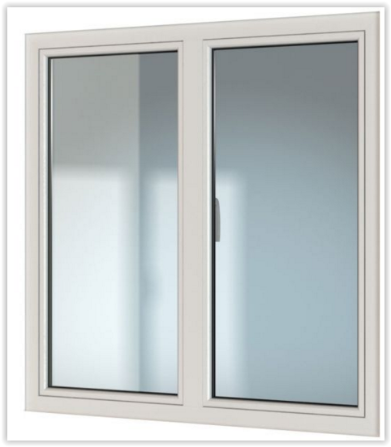
Window example

Slide 11
CPR
7 Basic requirements
Window example

Slide 12
CPR
7 Basic requirements
Window example
Harmonised Standard

Slide 13
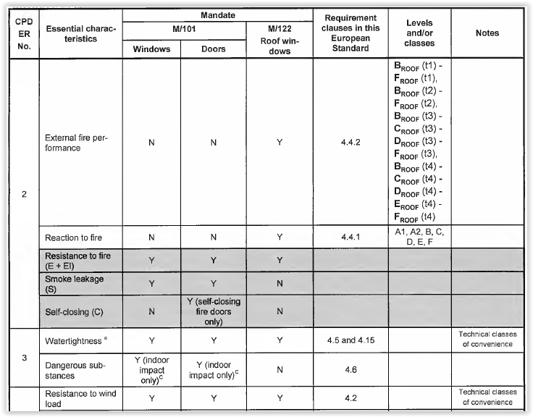
CPR
7 Basic requirements
Window example
Harmonised Standard
EN 14351-1 Windows and doors, Annex ZA

Slide 14
CPR
7 Basic requirements
Window example
Harmonised Standard
EN 14351-1 Windows and doors, Annex ZA
Essential Characteristics
Resistance to fire
test method
Thermal transmittance
test method
Acoustic performance
test method

Slide 15
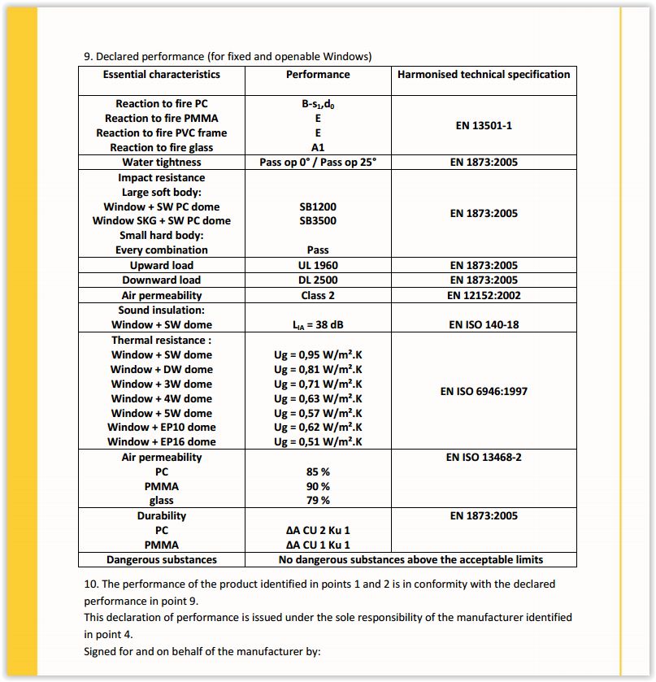
CPR
7 Basic requirements
Window example
Harmonised Standard
EN 14351-1 Windows and doors, Annex ZA
Essential Characteristics
Resistance to fire
test method
Thermal transmittance
test method
Acoustic performance
test method

Slide 16
CPR
7 Basic requirements
Window example
Harmonised Standard
Essential Characteristics
The scope of the NWIP covers both properties under essential characteristics and properties not covered by essential characteristics
Resistance to fire
test method
Thermal transmittance
None Essential Characteristics
test method
Acoustic performance
Operating forces
test method
test method
Mechanical strength
test method
Bullet resistance
test method

Slide 17
CPR
7 Basic requirements
Window example
Harmonised Standard
Window
Define the product type
Essential Characteristics
Resistance to fire
test method
Thermal transmittance
None Essential Characteristics
test method
Acoustic performance
Operating forces
test method
test method
Mechanical strength
test method
Bullet resistance
test method

Slide 18
CPR
7 Basic requirements
Window example
European common technical language
Harmonised Standard
Window
Essential Characteristics
Resistance to fire
test method
Thermal transmittance
None Essential Characteristics
test method
Acoustic performance
Operating forces
test method
test method
Mechanical strength
test method
Bullet resistance
test method

Slide 19
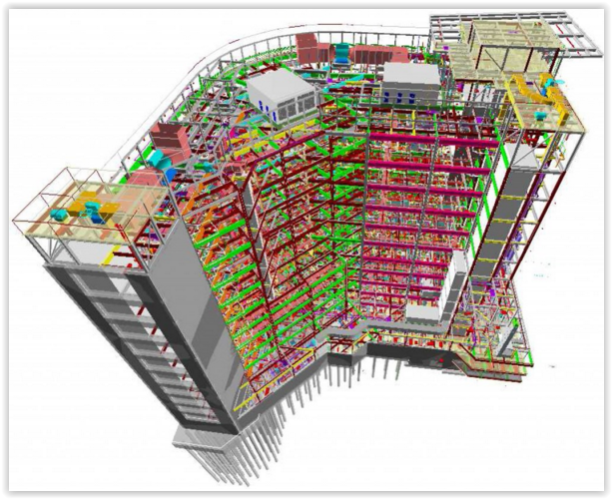
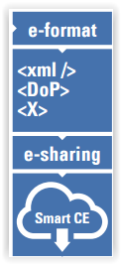
European Data Dictionary
Window
IFC
Property set EN14351-1
Resistance to fire
test method
Thermal transmittance
test method
PIM/DAM
Acoustic performance
test method

Slide 20
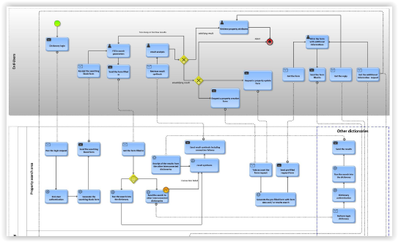
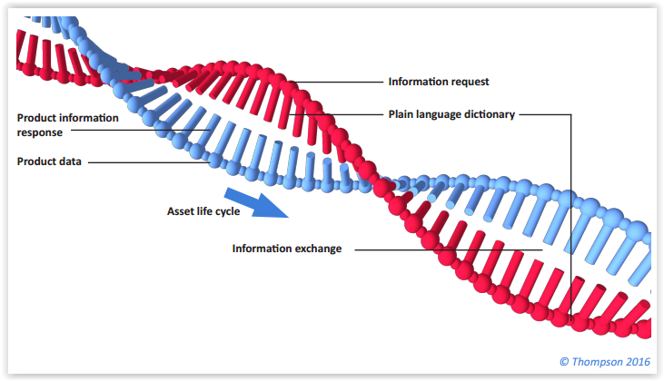
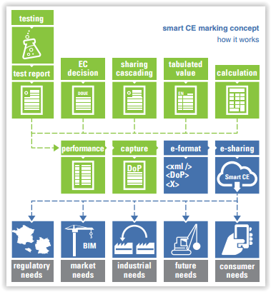
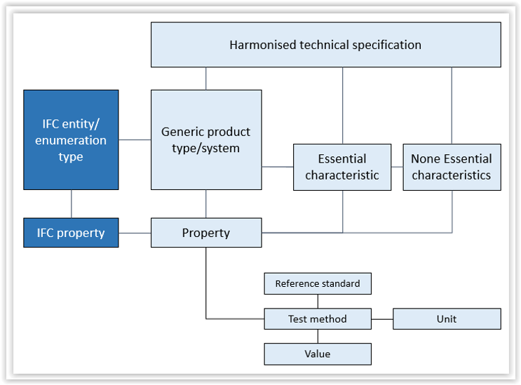
Relation between smart CE marking and works within CEN/TC 442 WG4
NWIP 1&2
PPBIM process
UK LEXiCON
NWIP 3&4
Product data template

Slide 21
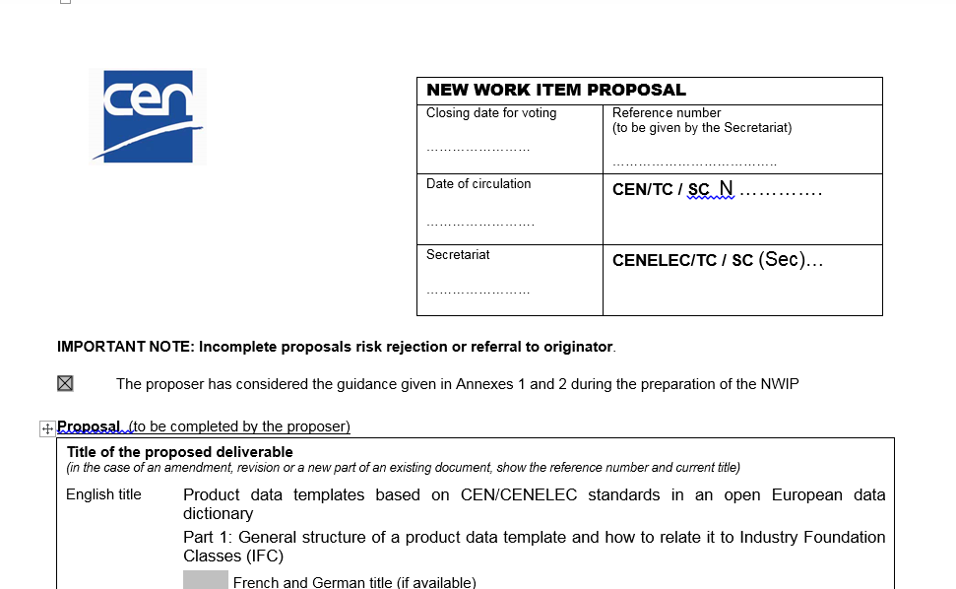
CEN/TC 442 – WG4, New Work Item Proposal Product data templates based on CEN/CENELEC standards in an open European Data Dictionary General structure of a product data template and how to relate to Industry Foundations Classes (IFC)

Slide 22
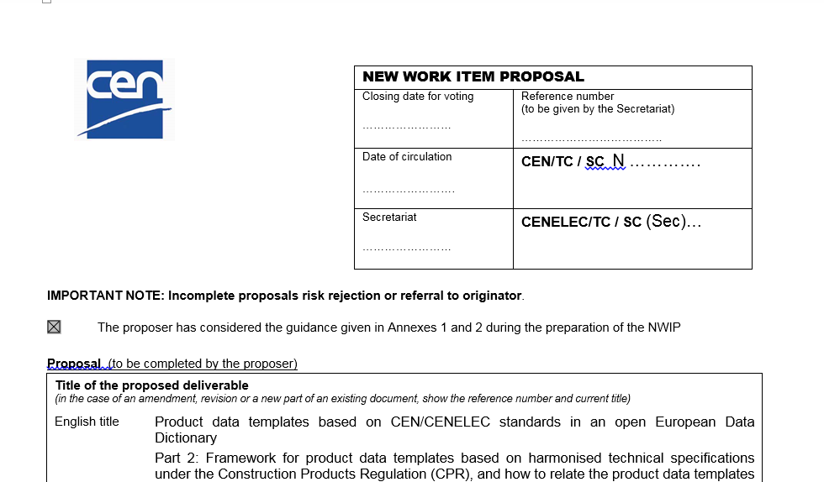
CEN/TC 442 – WG4, New Work Item Proposal Product data templates based on CEN/CENELEC standards in an open European Data Dictionary. Part 2: Framework for product data templates based on harmonised technical specifications under the Construction Products Regulation (CPR), and how to relate the product data templates to Industry Foundation Classes (IFC)

Slide 23
no.linkedin.com/in/fredenlund
Lars Chr. Fredenlund
CEO coBuilder AS
TWITTER
WWW.COBUILDER.COM
twitter.com/@_fredenlund
WWW.GOBIM.COM
LINKEDIN
no.linkedin.com/in/fredenlund
WWW.PRODUCTXCHANGE:COM
FACEBOOK
WWW.FACEBOOK.COM/cobuilder.international
fredenlund@cobuilder.com
(+47) 95724990

