Slide 1

Supply Chain Pecha Kucha
Foto: Oliver Guillard (unsplash.com)

Slide 2
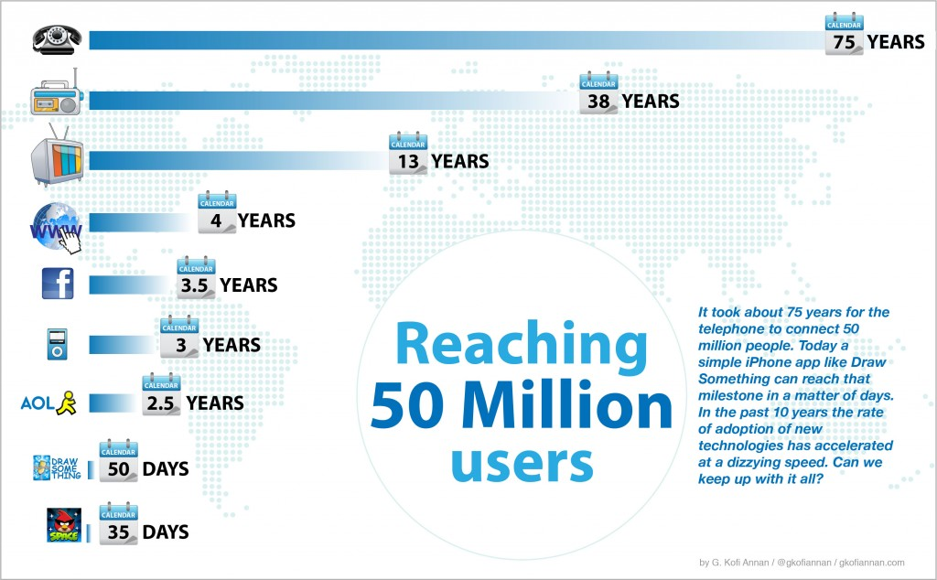

Slide 3

Foto: Quino Ai (unsplash.com)

Slide 4

Foto: Igor Ovsyannykov (unsplash.com)

Slide 5
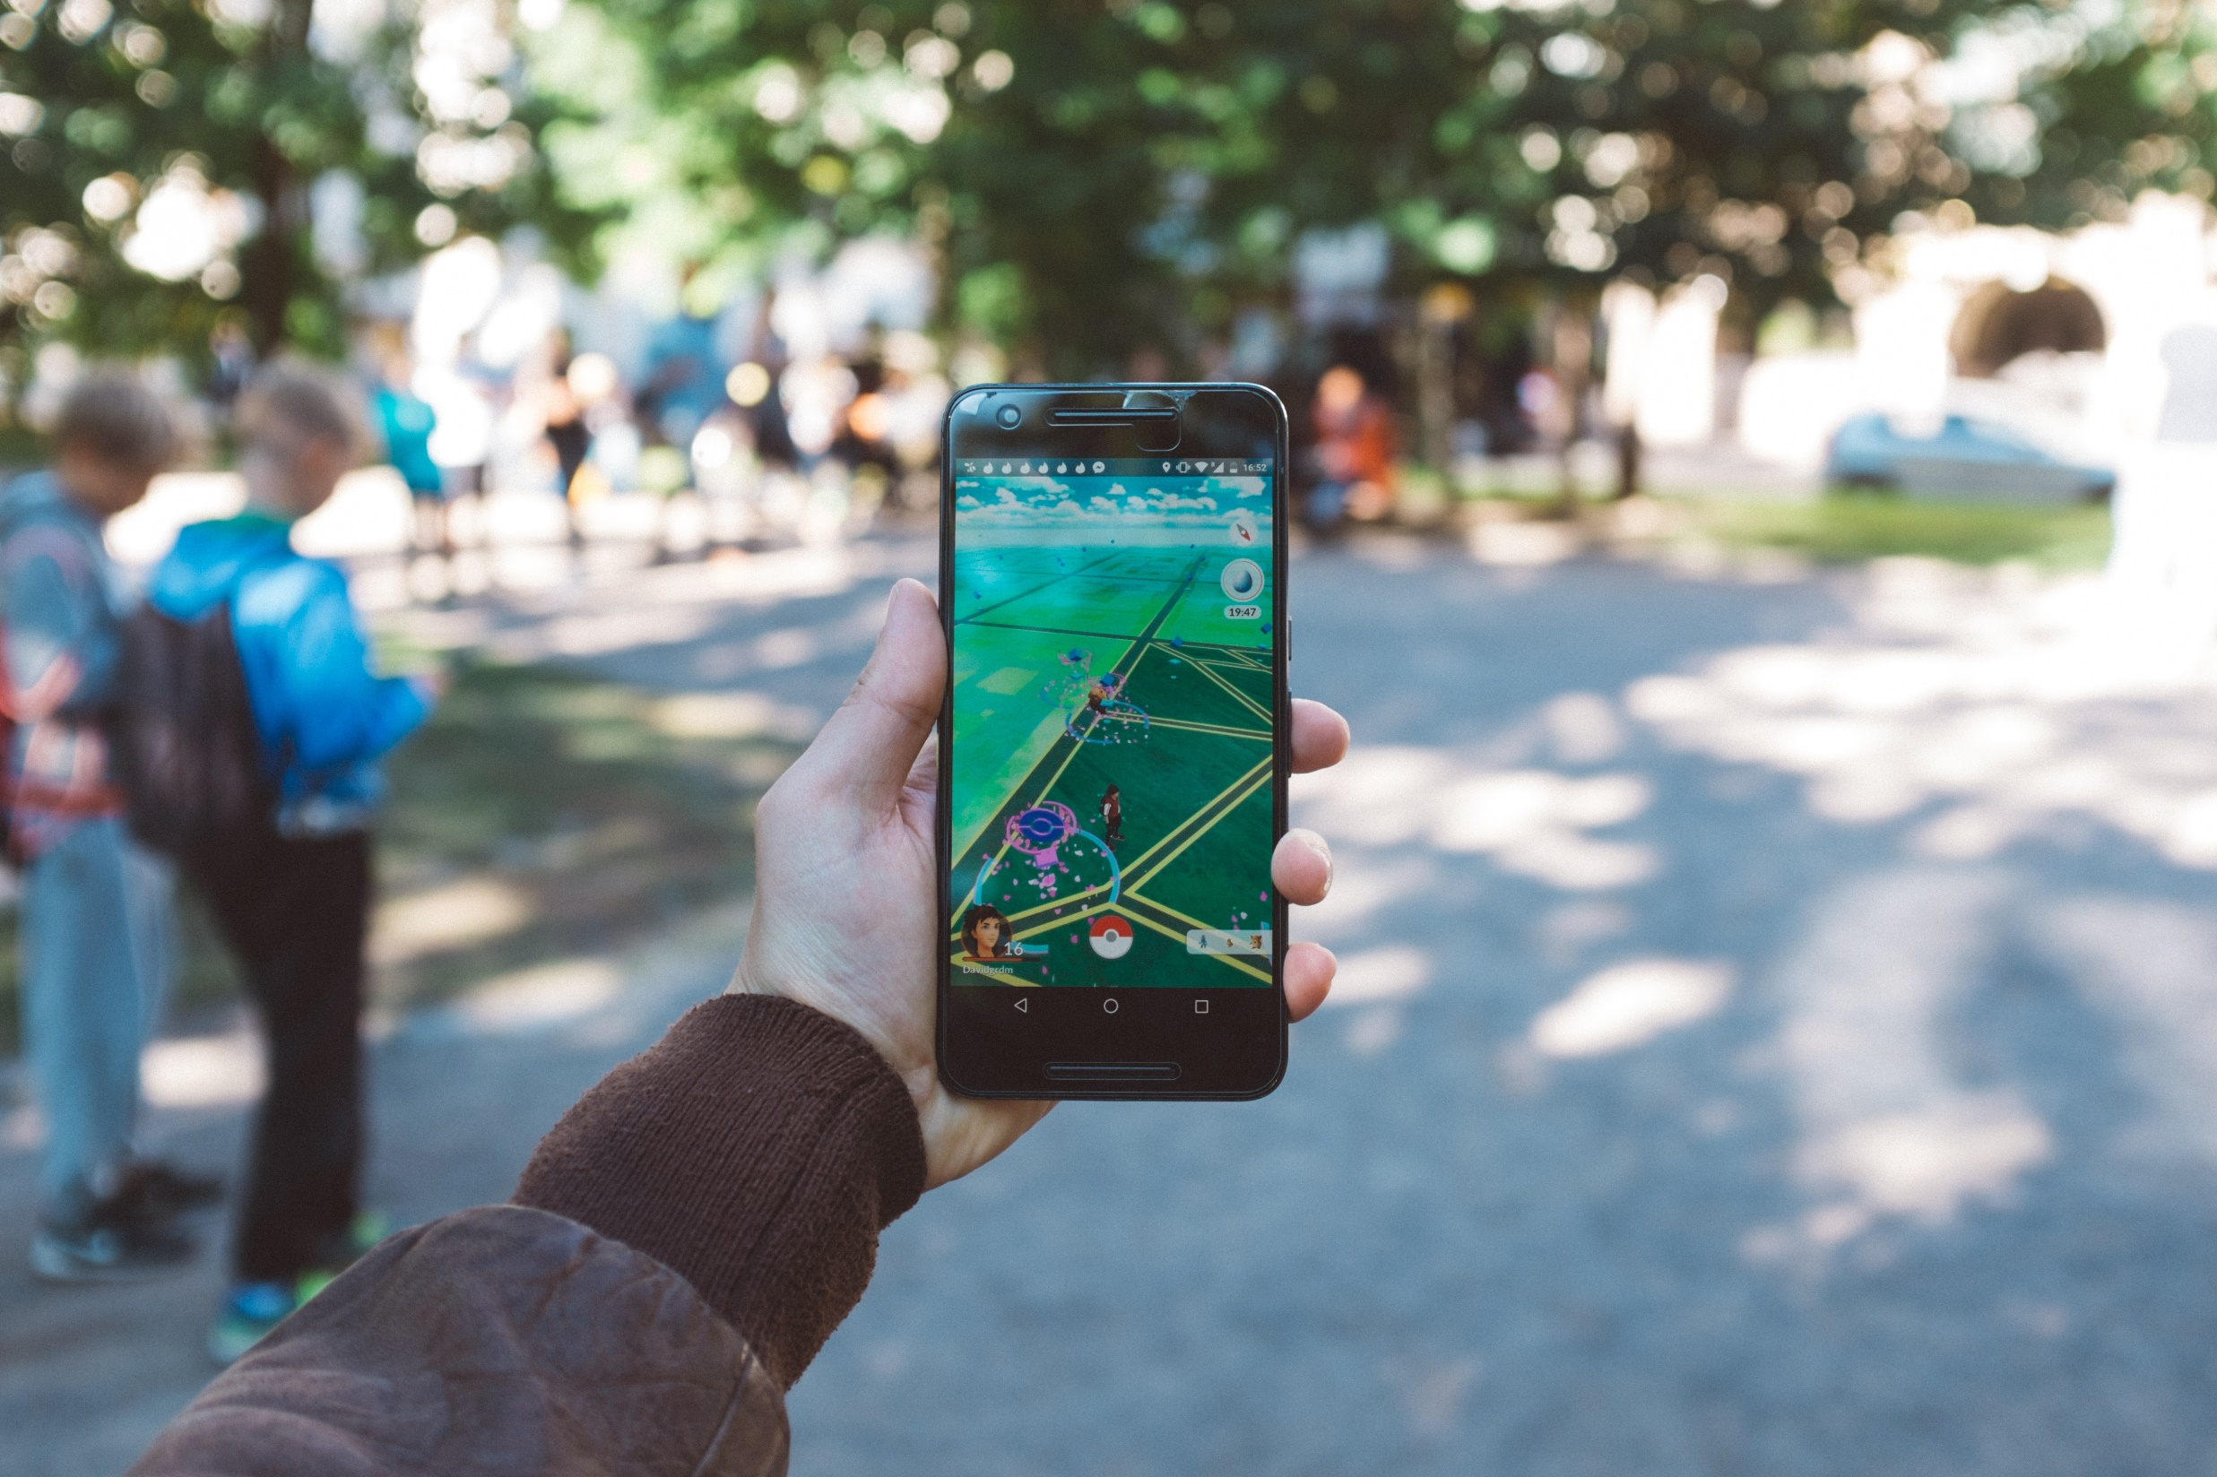
Foto: David Grandmougin (unsplash.com)

Slide 6

Foto: Oliver Guillard (unsplash.com)

Slide 7

Foto: Hubud

Slide 8

Foto: Aftenposten

Slide 9
Supply Chain Pecha Kucha
Foto: Oliver Guillard (unsplash.com)

